Slide 1
TIC TAC TOE
Members
Peter Christian Almoroto Justine Macayanga
Ulysses Joi Almoroto Adrian Manigos
Jasper Amper Arvell Galarpot
NAME OF PRESENTER
Designation

Slide 2
INTRODUCTION
Tic Tac Toe, a classic two-player strategy game, serves as an engaging platform for logical reasoning and decision-making. This project is designed to replicate the game using object-oriented programming (OOP) principles. By leveraging OOP concepts such as classes, objects, encapsulation, and inheritance, the development process emphasizes modularity, reusability, and clarity. Beyond entertainment, this endeavor provides a practical application of programming methodologies, showcasing the structured approach required to design and implement interactive systems effectively.

Slide 3
Objectives
To design a user-friendly console-based Tic Tac Toe game.
To implement OOP principles in designing the game's structure.
To provide an interactive experience for players, with clear instructions and valid input checks.
To demonstrate the use of algorithms for win detection and game flow management.

Slide 4
Scope and Delimitation
The project focuses on implementing a Tic Tac Toe game for two players. The game is designed for execution in a console environment. It supports basic functionalities, including board display, player input, and result evaluation (win, lose, or draw). The study does not extend to developing online multiplayer functionalities.

Slide 5
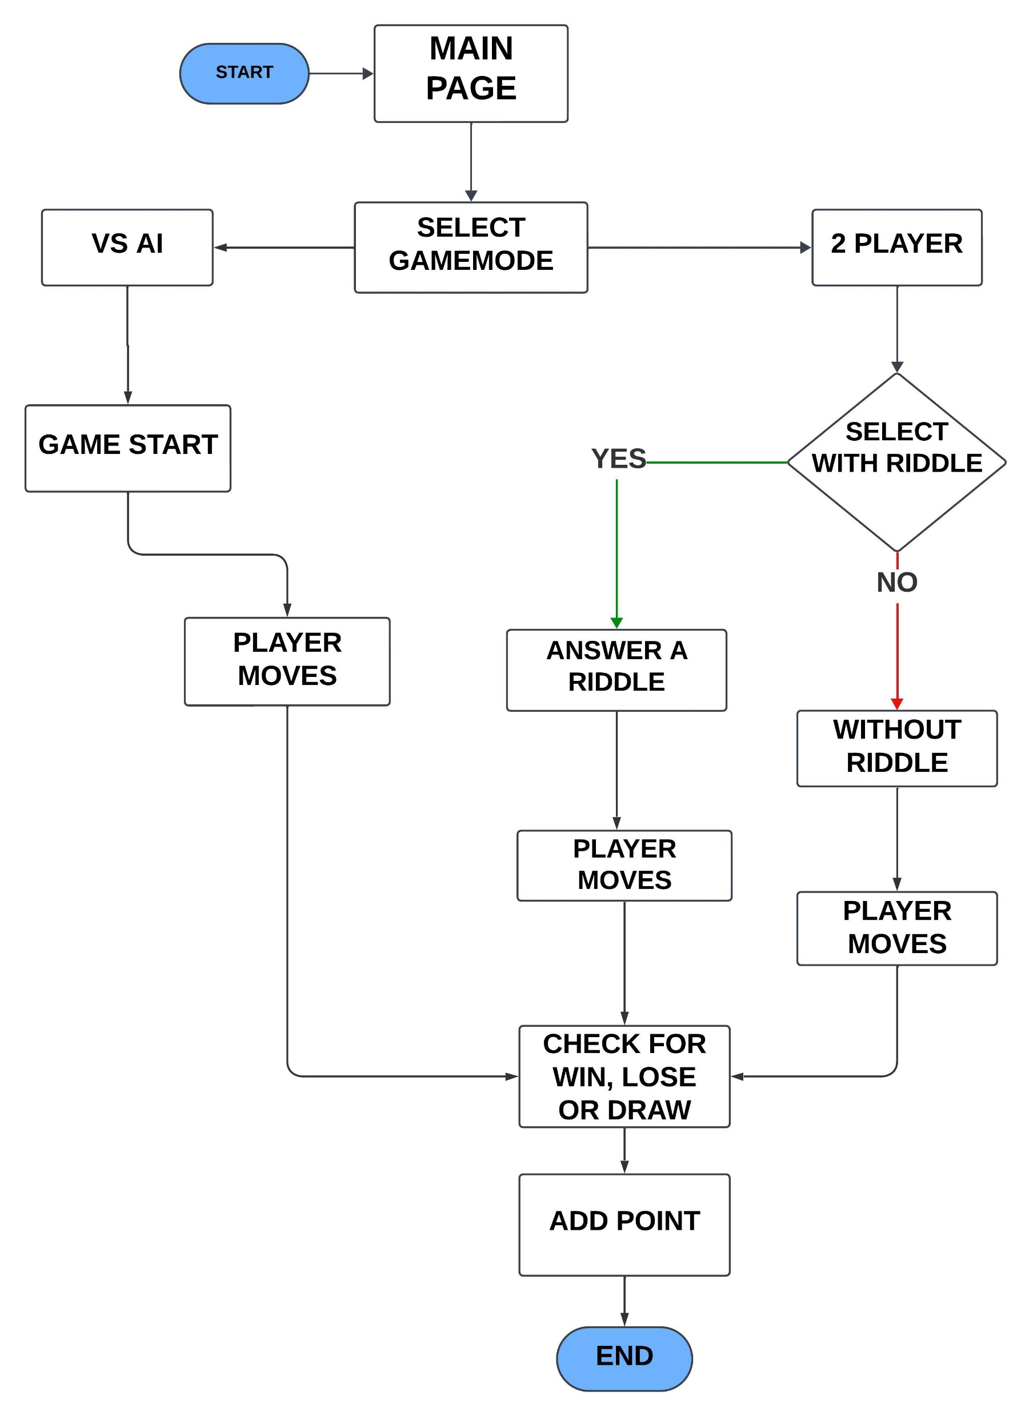
FLOWCHART

Slide 6
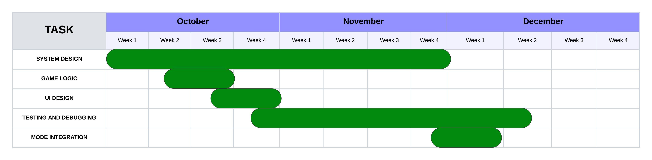
GANTT CHART

Slide 7
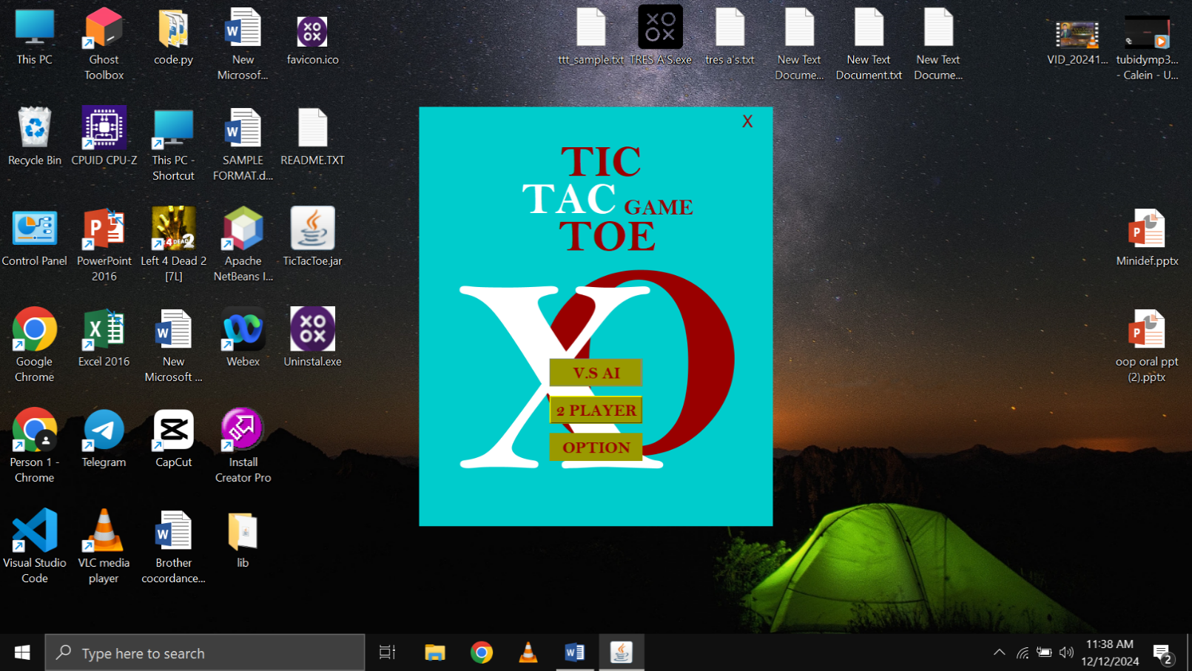
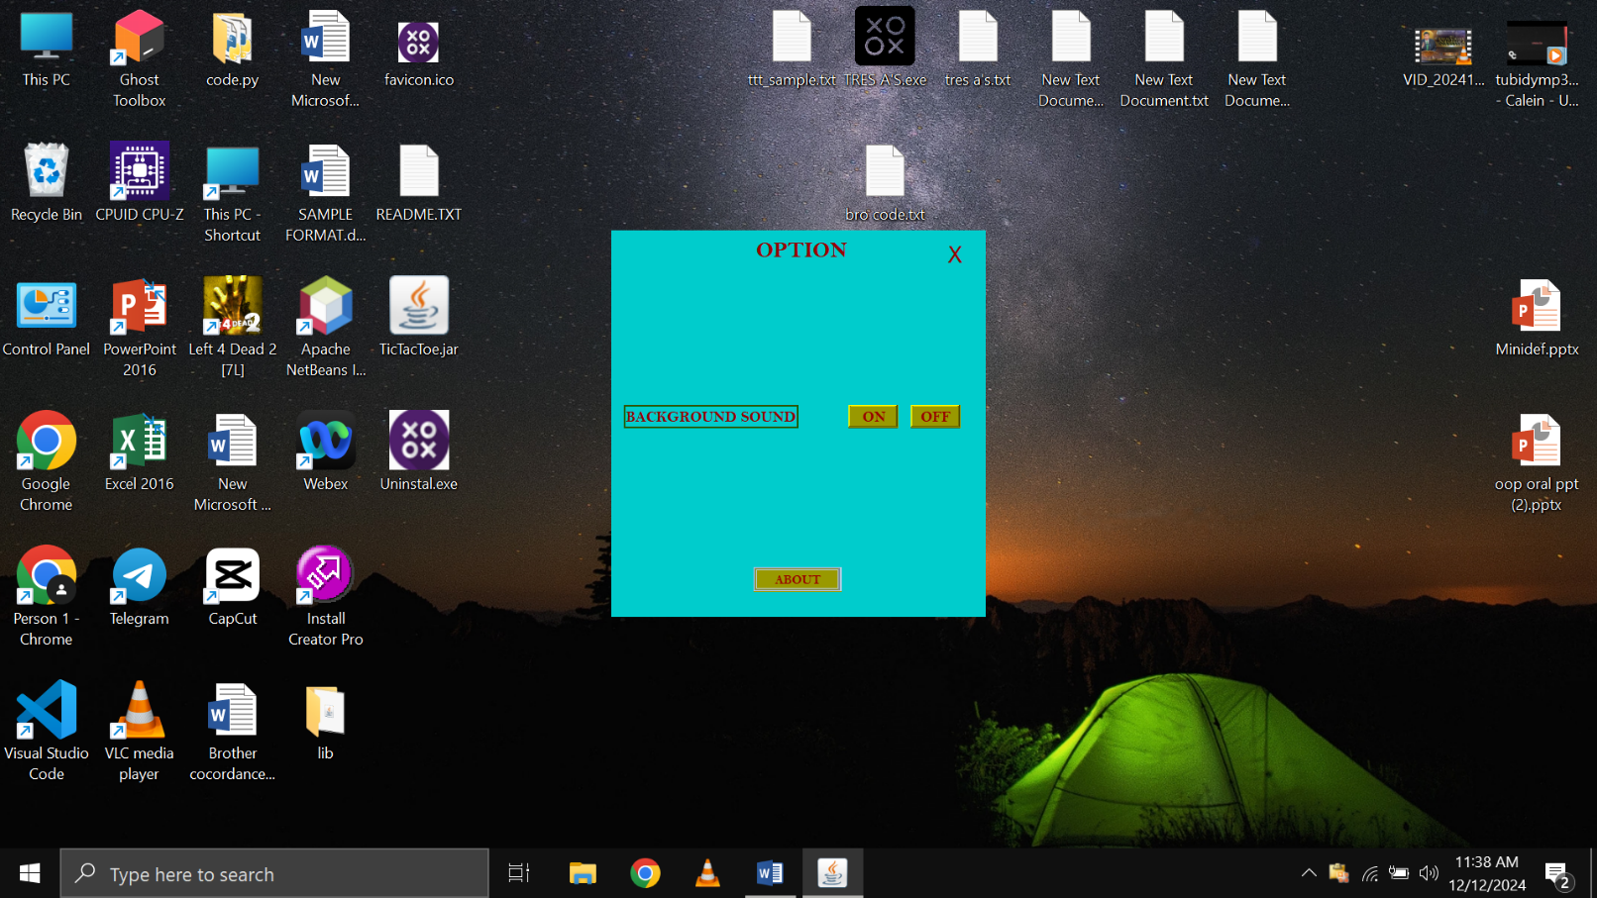
SYSTEM DESIGN
Fig 1.
The Figure 1 shows the menu page of the game Tic Tac Toe.
Fig 2.
This figure shows the option of the game Tic Tac Toe game. This include the button for the sound effects of the game and the “About” button for the instruction.

Slide 8
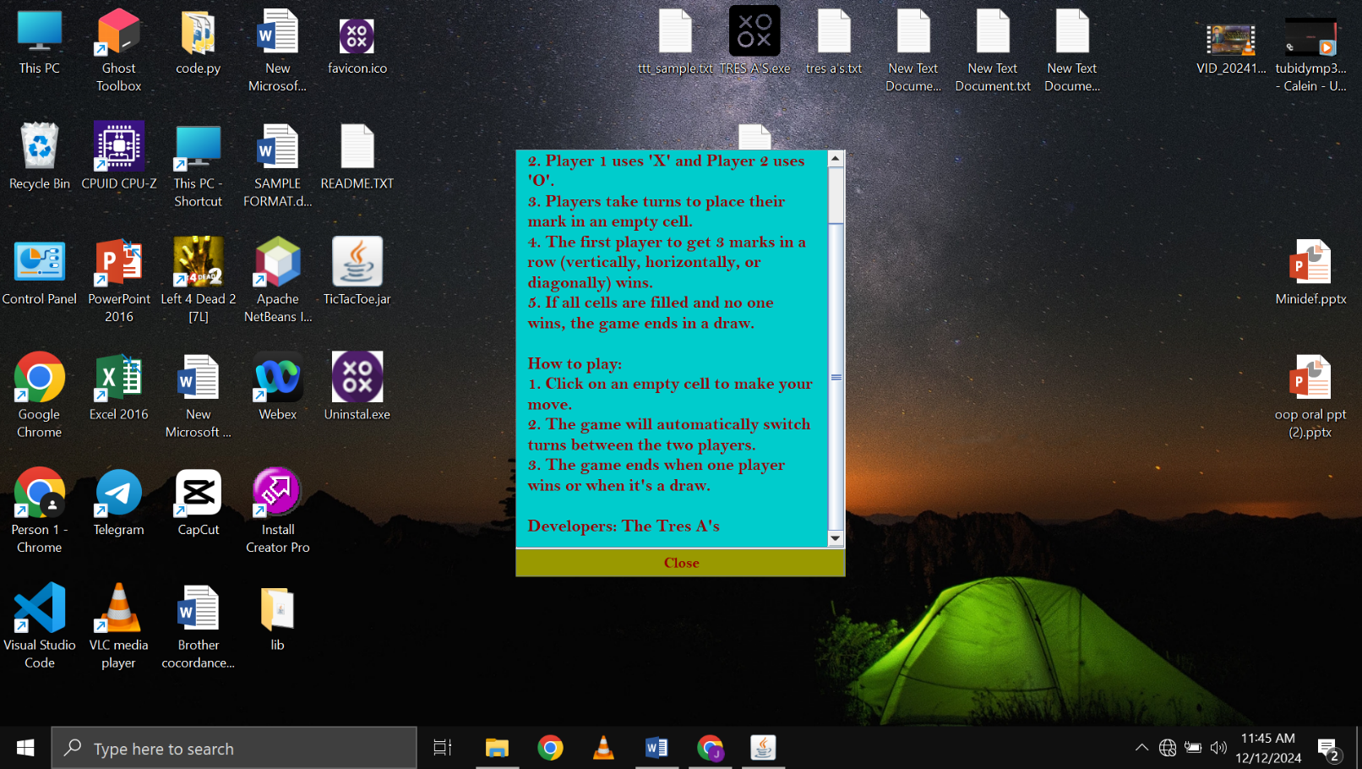


SYSTEM DESIGN
Fig 3.
This figure shows the instruction of the game for a guide for the new players.
Fig 4.
It shows the mode of the 2 player if they want to play with the riddle or without the riddle.

Slide 9
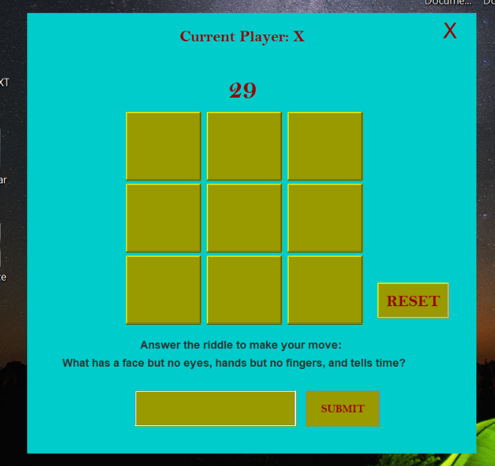
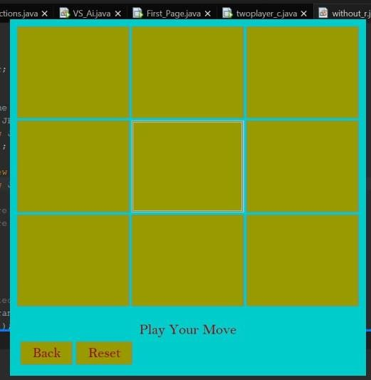
SYSTEM DESIGN
Fig 5.
This is the Board of the 2 player with a riddle, it shows the input of the player for the riddle and the scoring of the players.
Fig 6.
This figure is the board of the VS AI and the 2 player without a riddle, they have the same design for the consistency of the system or the game Tic Tac Toe.

Slide 10
CONCLUSION
The development of the Tic Tac Toe game demonstrates the practical application of object-oriented programming principles. By focusing on modular design, the project ensures code reusability, scalability, and clarity, providing a solid foundation for future enhancements.

Slide 11
RECOMMENDATION
For future developments, it is recommended to:
1. Implement a graphical user interface (GUI) for improved user interaction.
2. Introduce a match history to see the last move of the opponent.
3. Enable online multiplayer functionality using network programming.

Slide 12


